Slide 1
FittracK Automated meal plan generation via mlp classification and constrained optimization
Student: Octavian COSTE
Îndrumător: S.l.dr.ing. Cristian AFLORI

Slide 2
Context
Problem
Solution
Nutrition planning is a key factor in achieving personal fitness goals.
Existing tools offer generic plans that ignore individual physiological profiles and personal constraints.
FitTrack automates personalized meal plan generation by calculating BMR and TDEE, then applying MLP classification and constrained optimization to generate tailored daily meal plans.

Slide 3
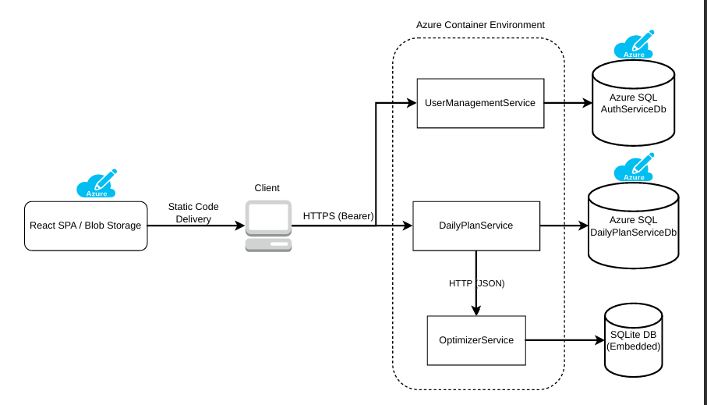
System architecture
3 containerized microservices
Independent databases per service
Bearer JWT Authentication
Internal HTTP communication

Slide 4
Authentication & security
Bearer JWT stored in memory – never persisted to localStorage
Short-lived access tokens minimize stolen token damage window
Refresh token stored server-side in DB and transmitted via HttpOnly cookie – inaccessible to JavaScript
Refresh token rotation – replace token on refresh
CSRF attacks not applicable – Bearer header is sent by the React App

Slide 5

Optimizer service
MLP Classifier
Pre-trained neural network for meal selection
Input: calorie target, protein target, minimum fat
Output: top K most suitable meal ID’s
Trained offline, loaded at service startup
Training Top-K accuracy – Top1: 81%, Top5: 99.82%, Top15: 100%
Meal Optimizer (SLSQP)
Determines optimal ingredient portion sizes
Enforces minimum fat constraint
Category-specific bounds per ingredient (Dairy: 30-300g)
Objective function: $\min{ }{\left(cal_{current}−cal_{target}\right)}^{2}+20×{\left(protein_{current}−protein_{target}\right)}^{2}$

Slide 6
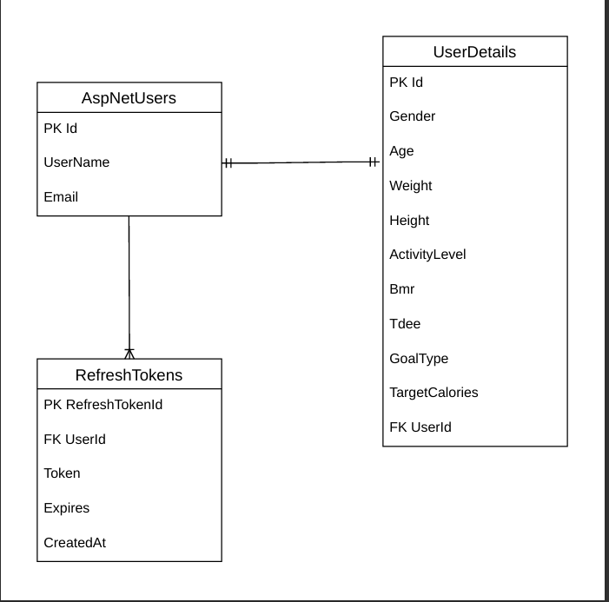
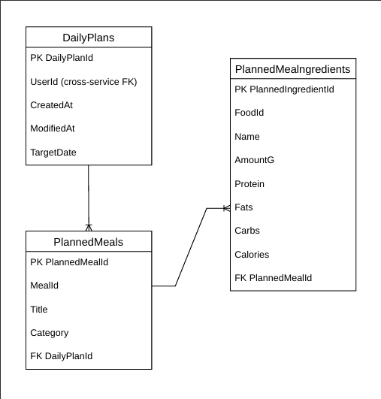
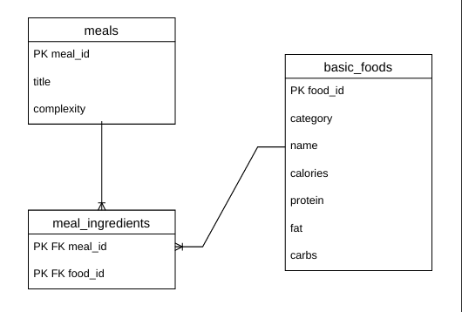
DATABASE STRATEGY
AuthServiceERD
DailyPlanServiceERD
OptimizerServiceERD

Slide 7
other implementations
Shared Project
AutoMapper
Serilog
Entity Framework Core
Common authentication configuration, global exception middleware and shared DTOs extracted into a dedicated project referenced by both .NET services
Domain model to DTO mapping configured per service, reducing boilerplate transformation code
Structured logging sink writing directly to Azure SQL
Logs persist in the ApplicationLogs table
ORM used for database interactions across both .NET services, with code-first migrations managing schema evolution

Slide 8
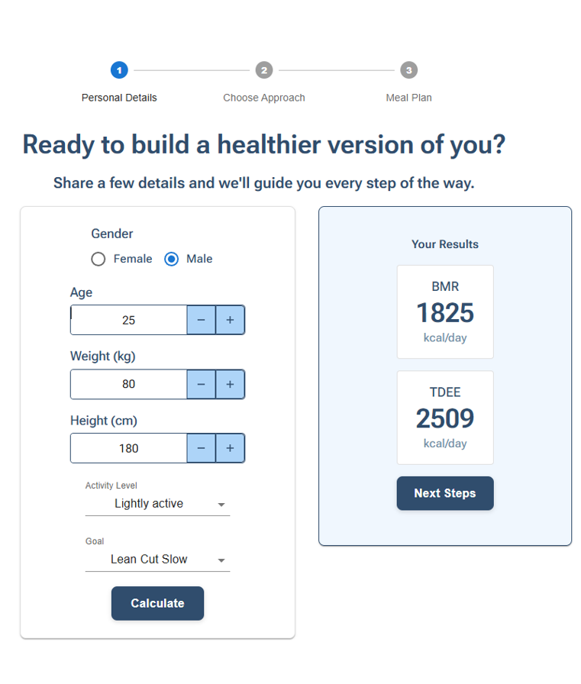
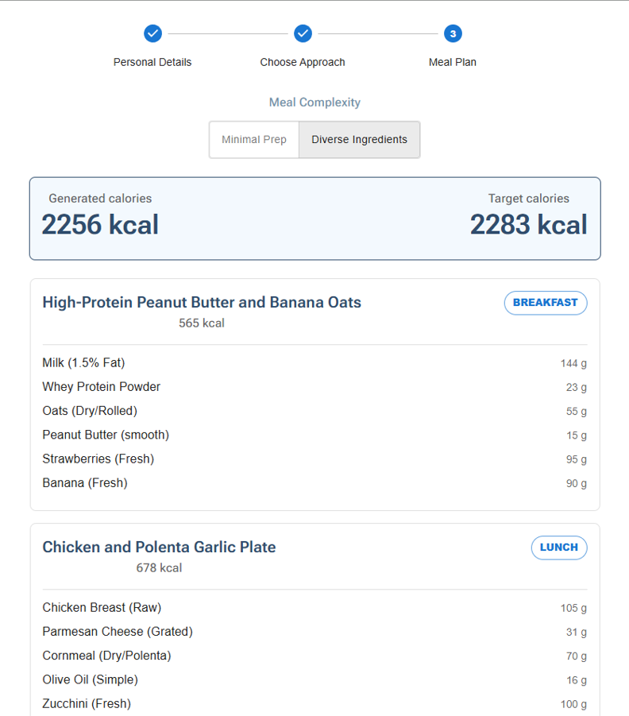
Application screenshots
Onboarding – Setting User’s Profile
Onboarding – User Previews AI generated meal

Slide 9
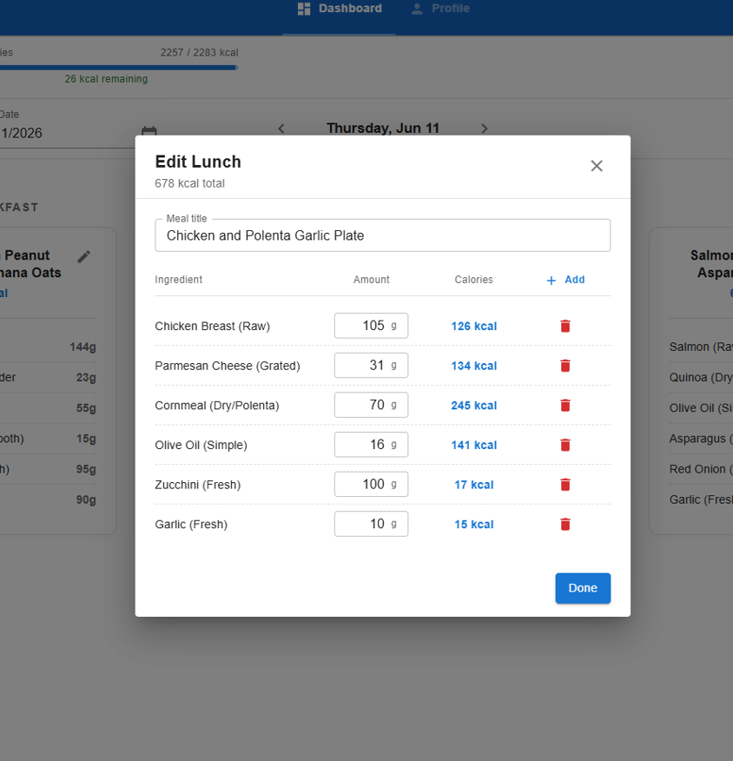
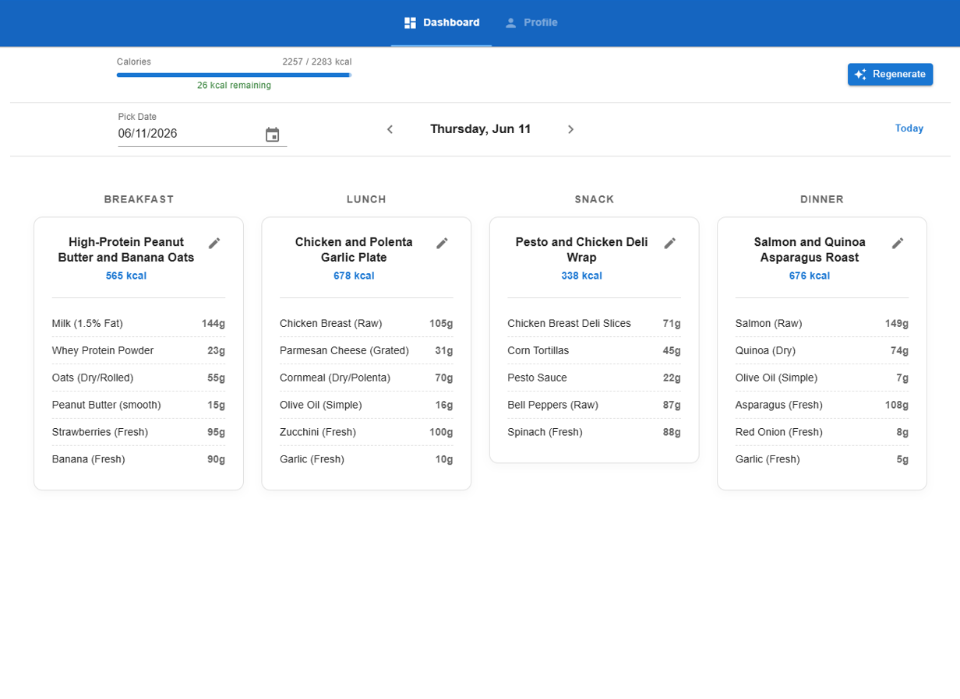
Application screenshots
Dashboard – Display user’s generated meal
Dashboard – User edits generated meal

Slide 10
Conclusions
Average end-to-end calorie error of 1.3% vs personalized target
Successfully automated personalized meal plan generation combining MLP classification and constrained optimization
Microservice architecture enabled independent deployment of each service
Secure cross-domain authentication via JWT + refresh token rotation
Future: constrain meal generation to user-available ingredients and ensure real world validation by tracking a user’s weight/energy over a month

Slide 11
Q&a
Thank you for your attention!

